Slide 1
BIO789P Biodiversity Survey & Spatial Analysis
Species distribution modelling
Joe White, Carolina Tovar, Moabe Fernandes, Felix Lim

Slide 2
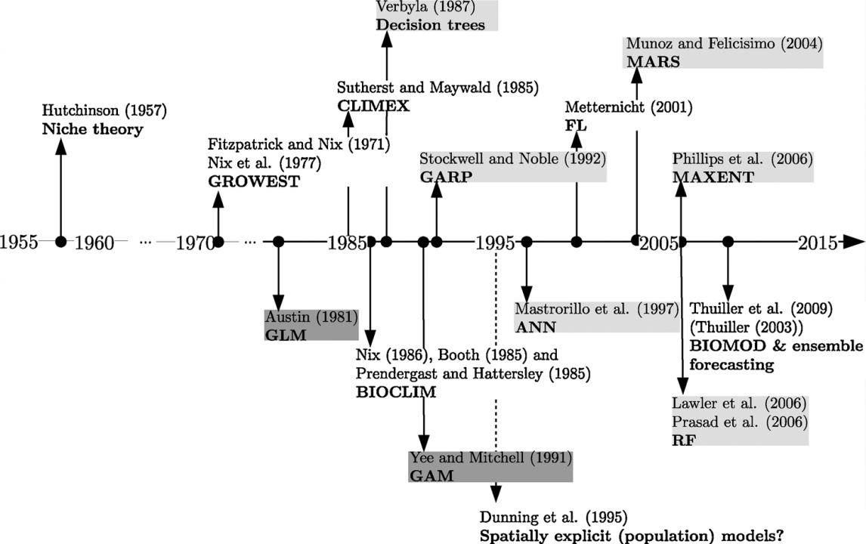
“These models [species distribution models] aim to define the species–environment relation and from this, estimate the species’ geographical distribution.” – Gobeyn et al. 2019
https://doi.org/10.1016/j.ecolmodel.2018.11.013

Slide 3
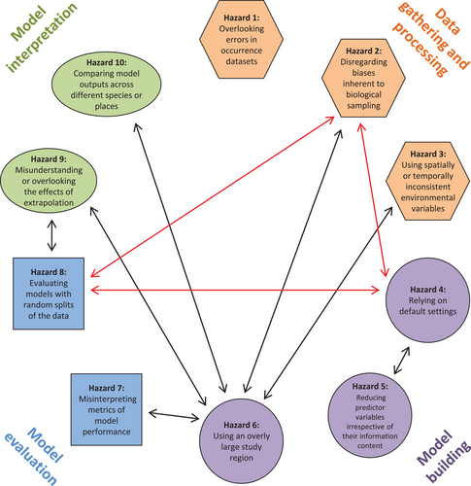
“Although the field [SDMs] has progressed rapidly regarding theory and implementation, key assumptions are still frequently violated and recommendations inadvertently overlooked. This leads to poor models being published and used in real-world applications.” – Soley-Guardia et al. 2024
https://doi.org/10.1111/ecog.06852

Slide 4
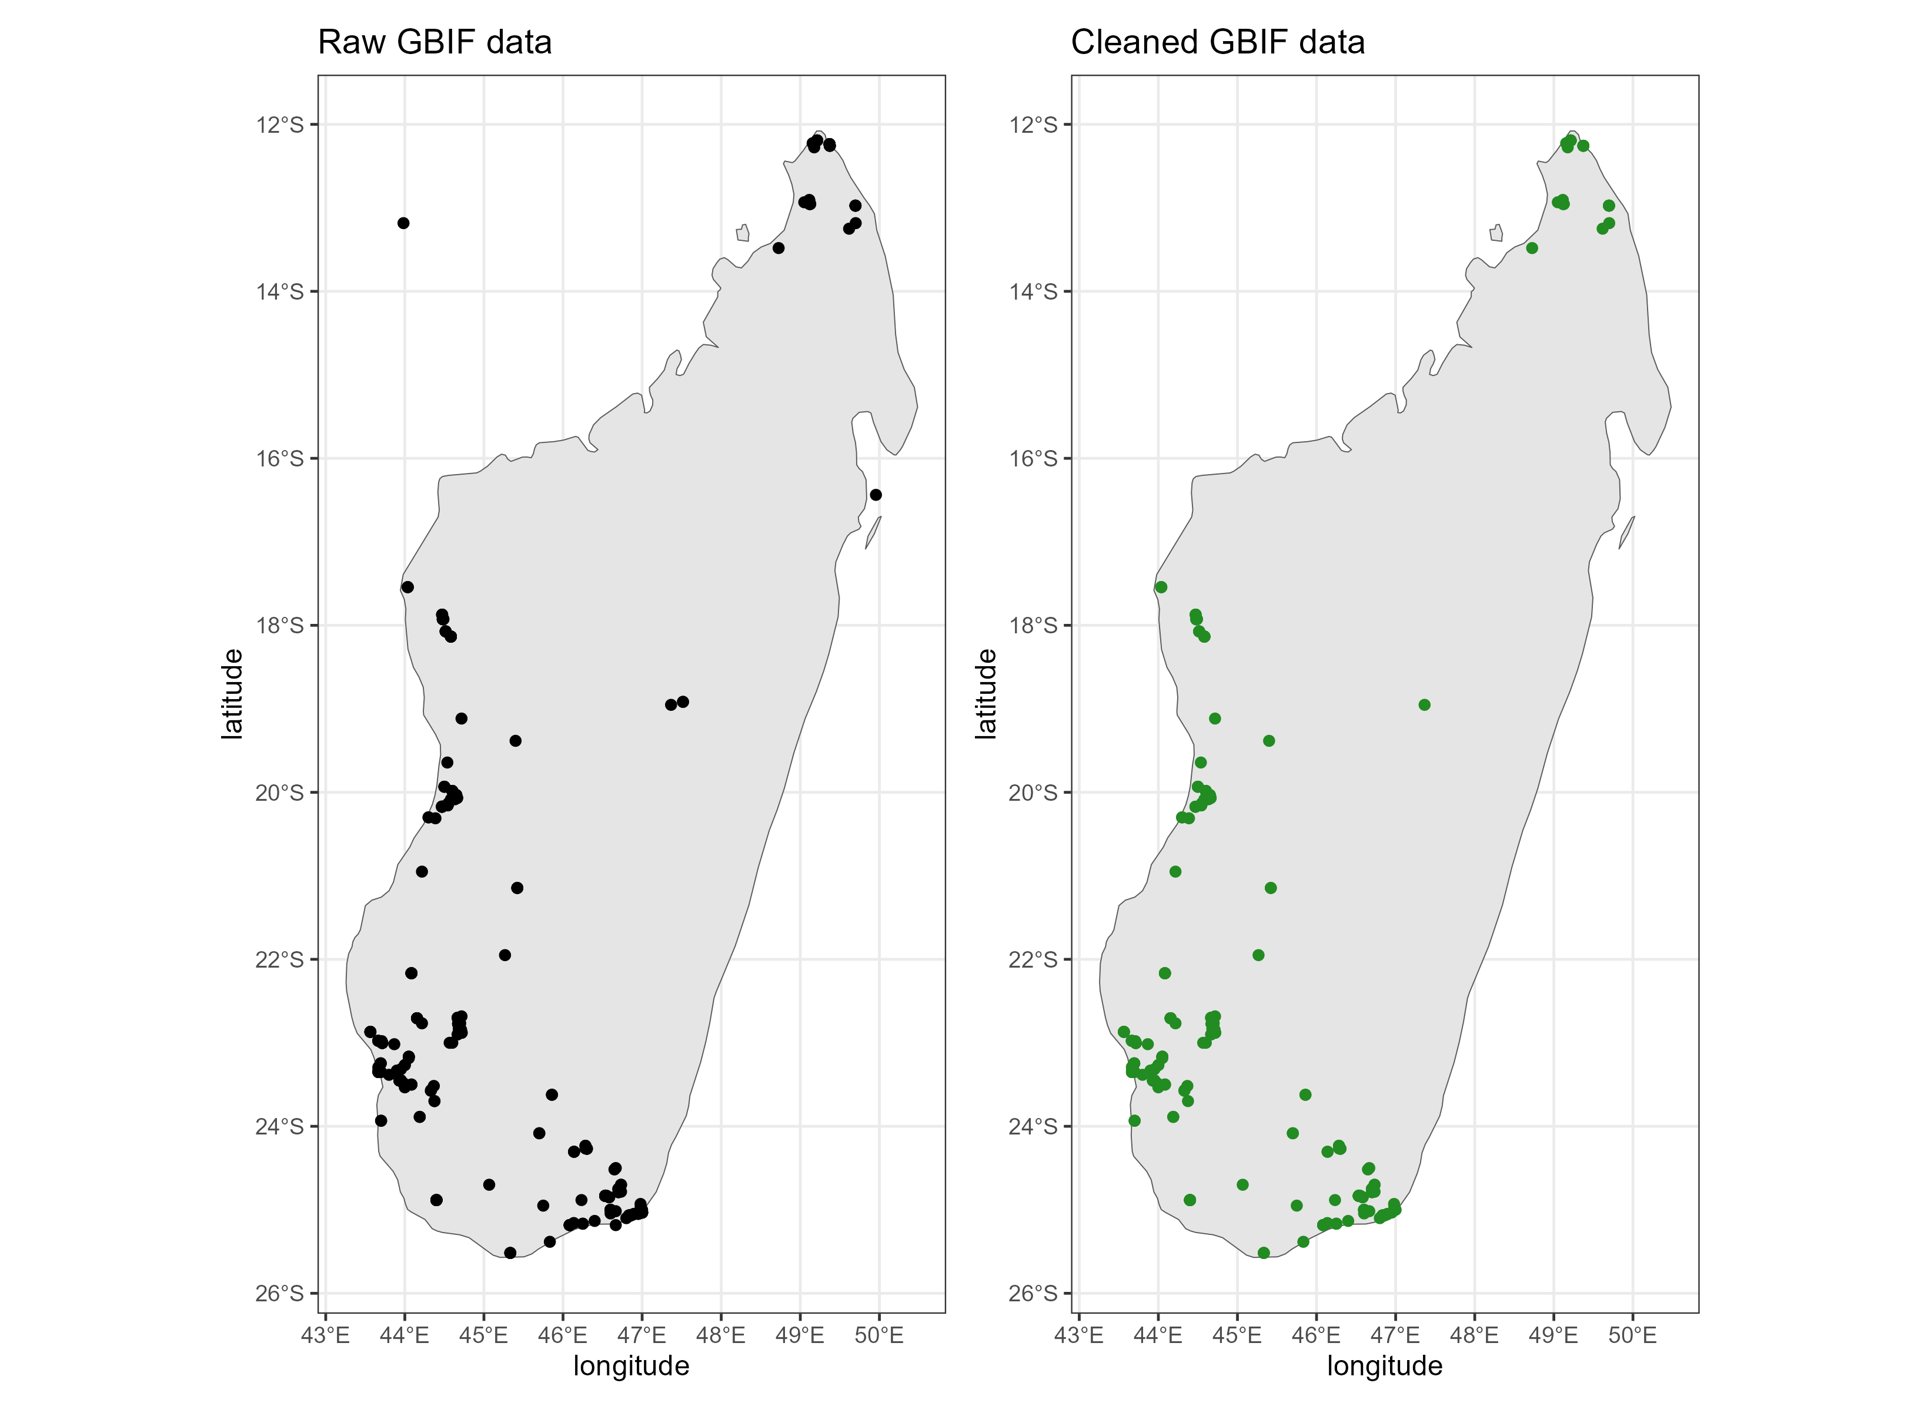
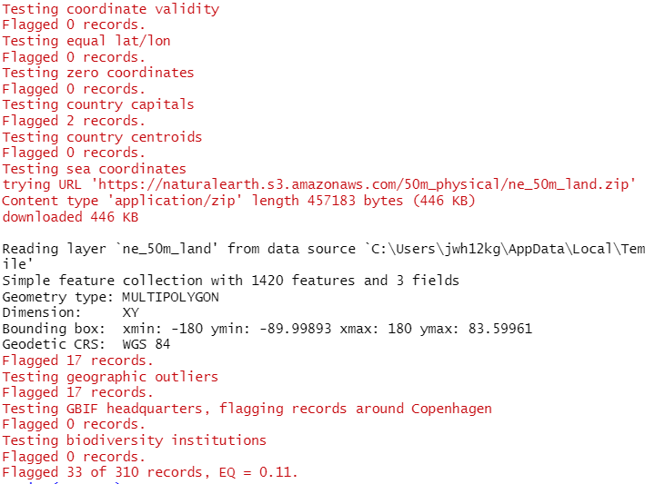
Hazard | Problem | Recommendation
1. Errors in occurrences | Georeferencing errors | CoordinateCleaner
CoordinateCleaner::clean_coordinates()

Slide 5
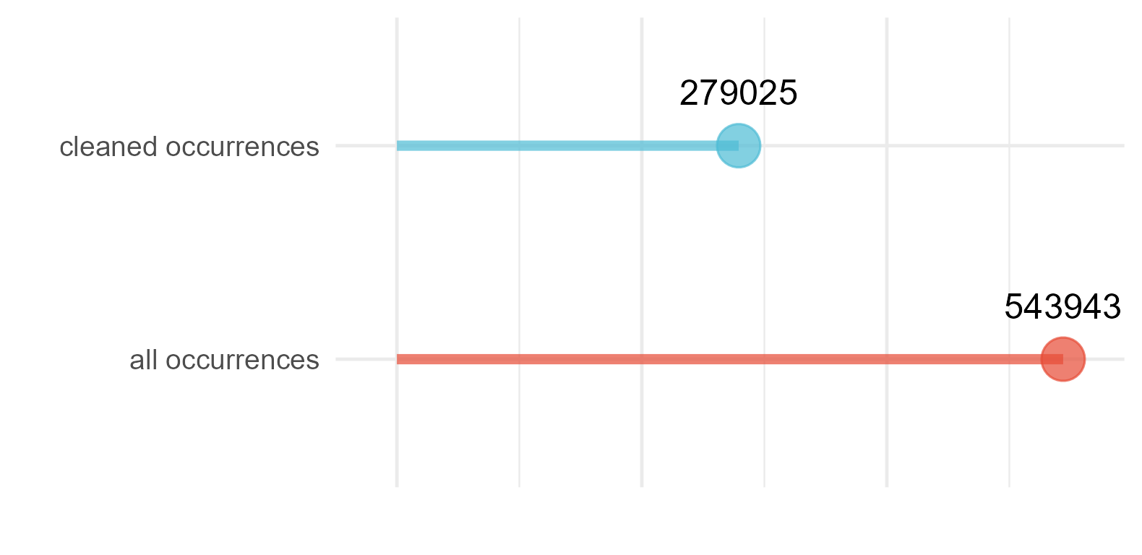
Hazard | Problem | Recommendation
1. Errors in occurrences | Georeferencing errors | CoordinateCleaner
CoordinateCleaner::clean_coordinates()
All available GBIF + BIEN occurrence records for Madagascar (as of end 2022)

Slide 6
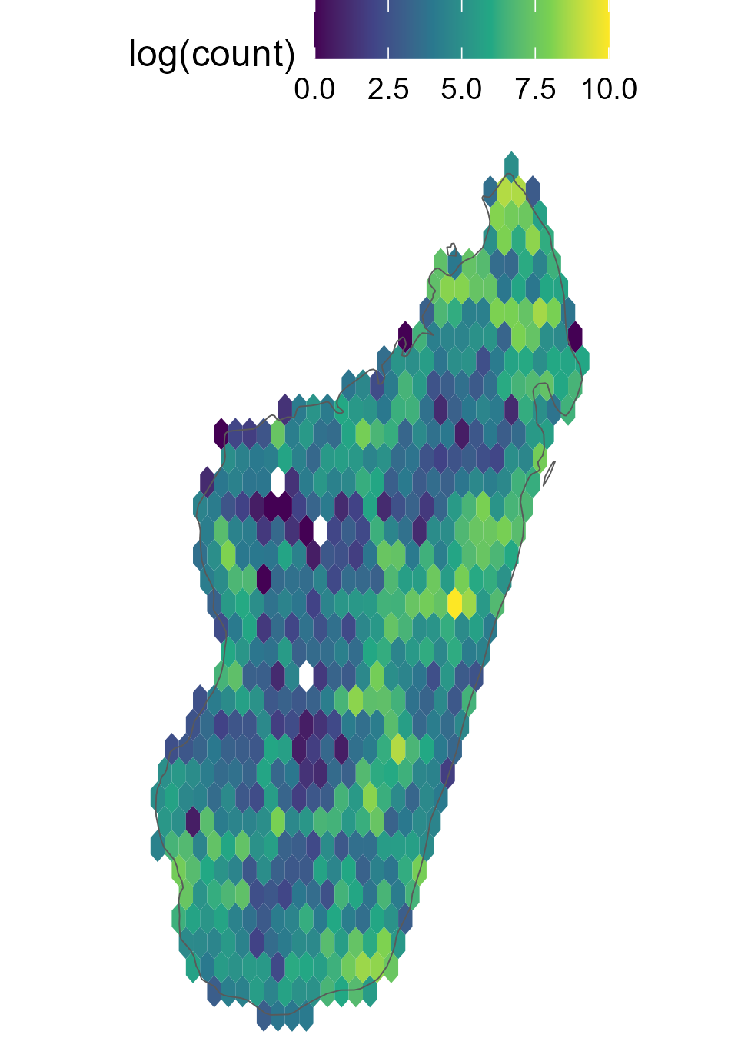
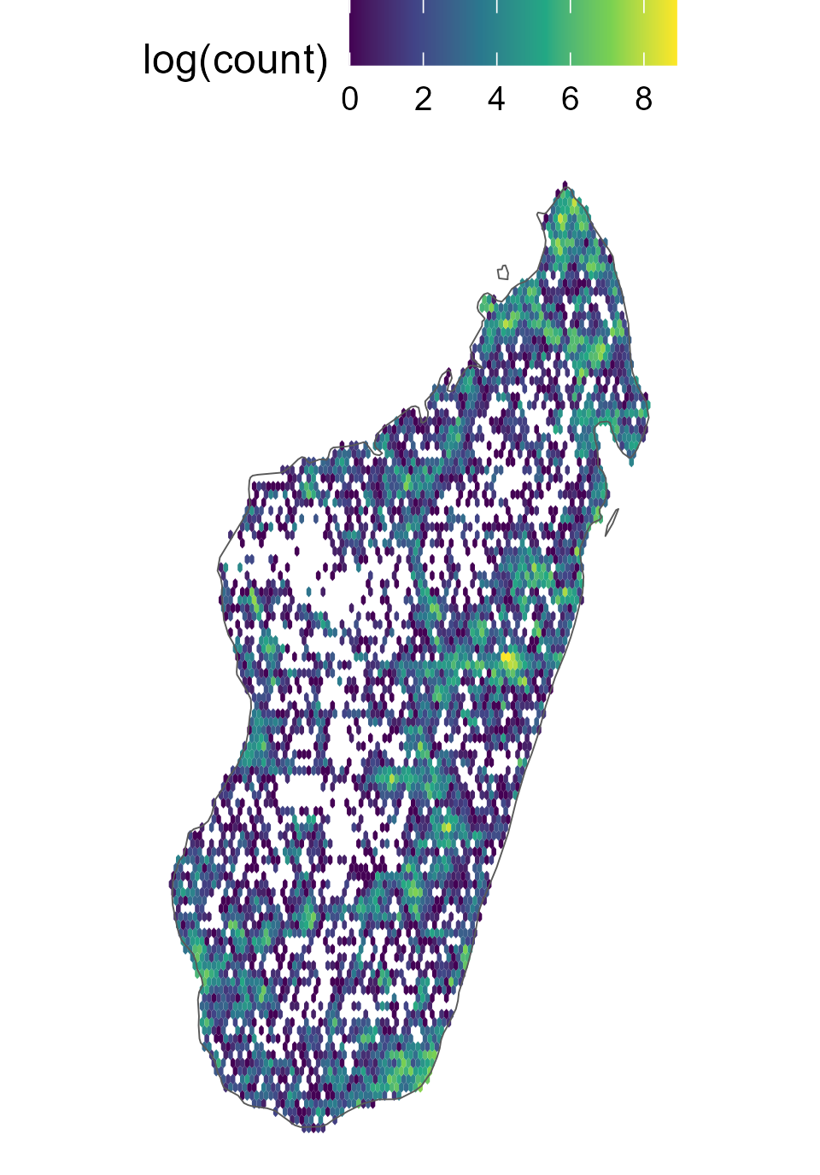
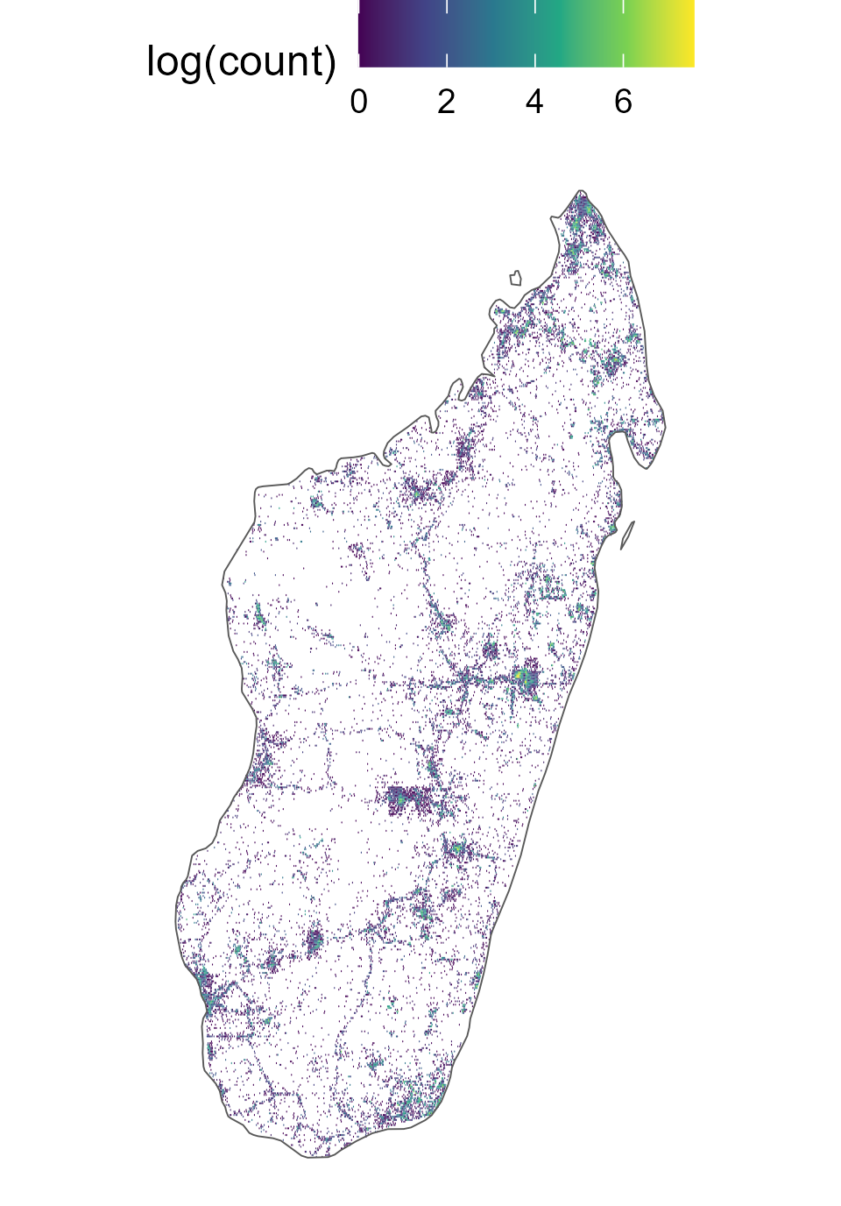
Hazard | Problem | Recommendation
2. Biases in biological sampling | Collection biases | Spatial thinning
Tourism
National Parks
Close to cities
Roads

Slide 7
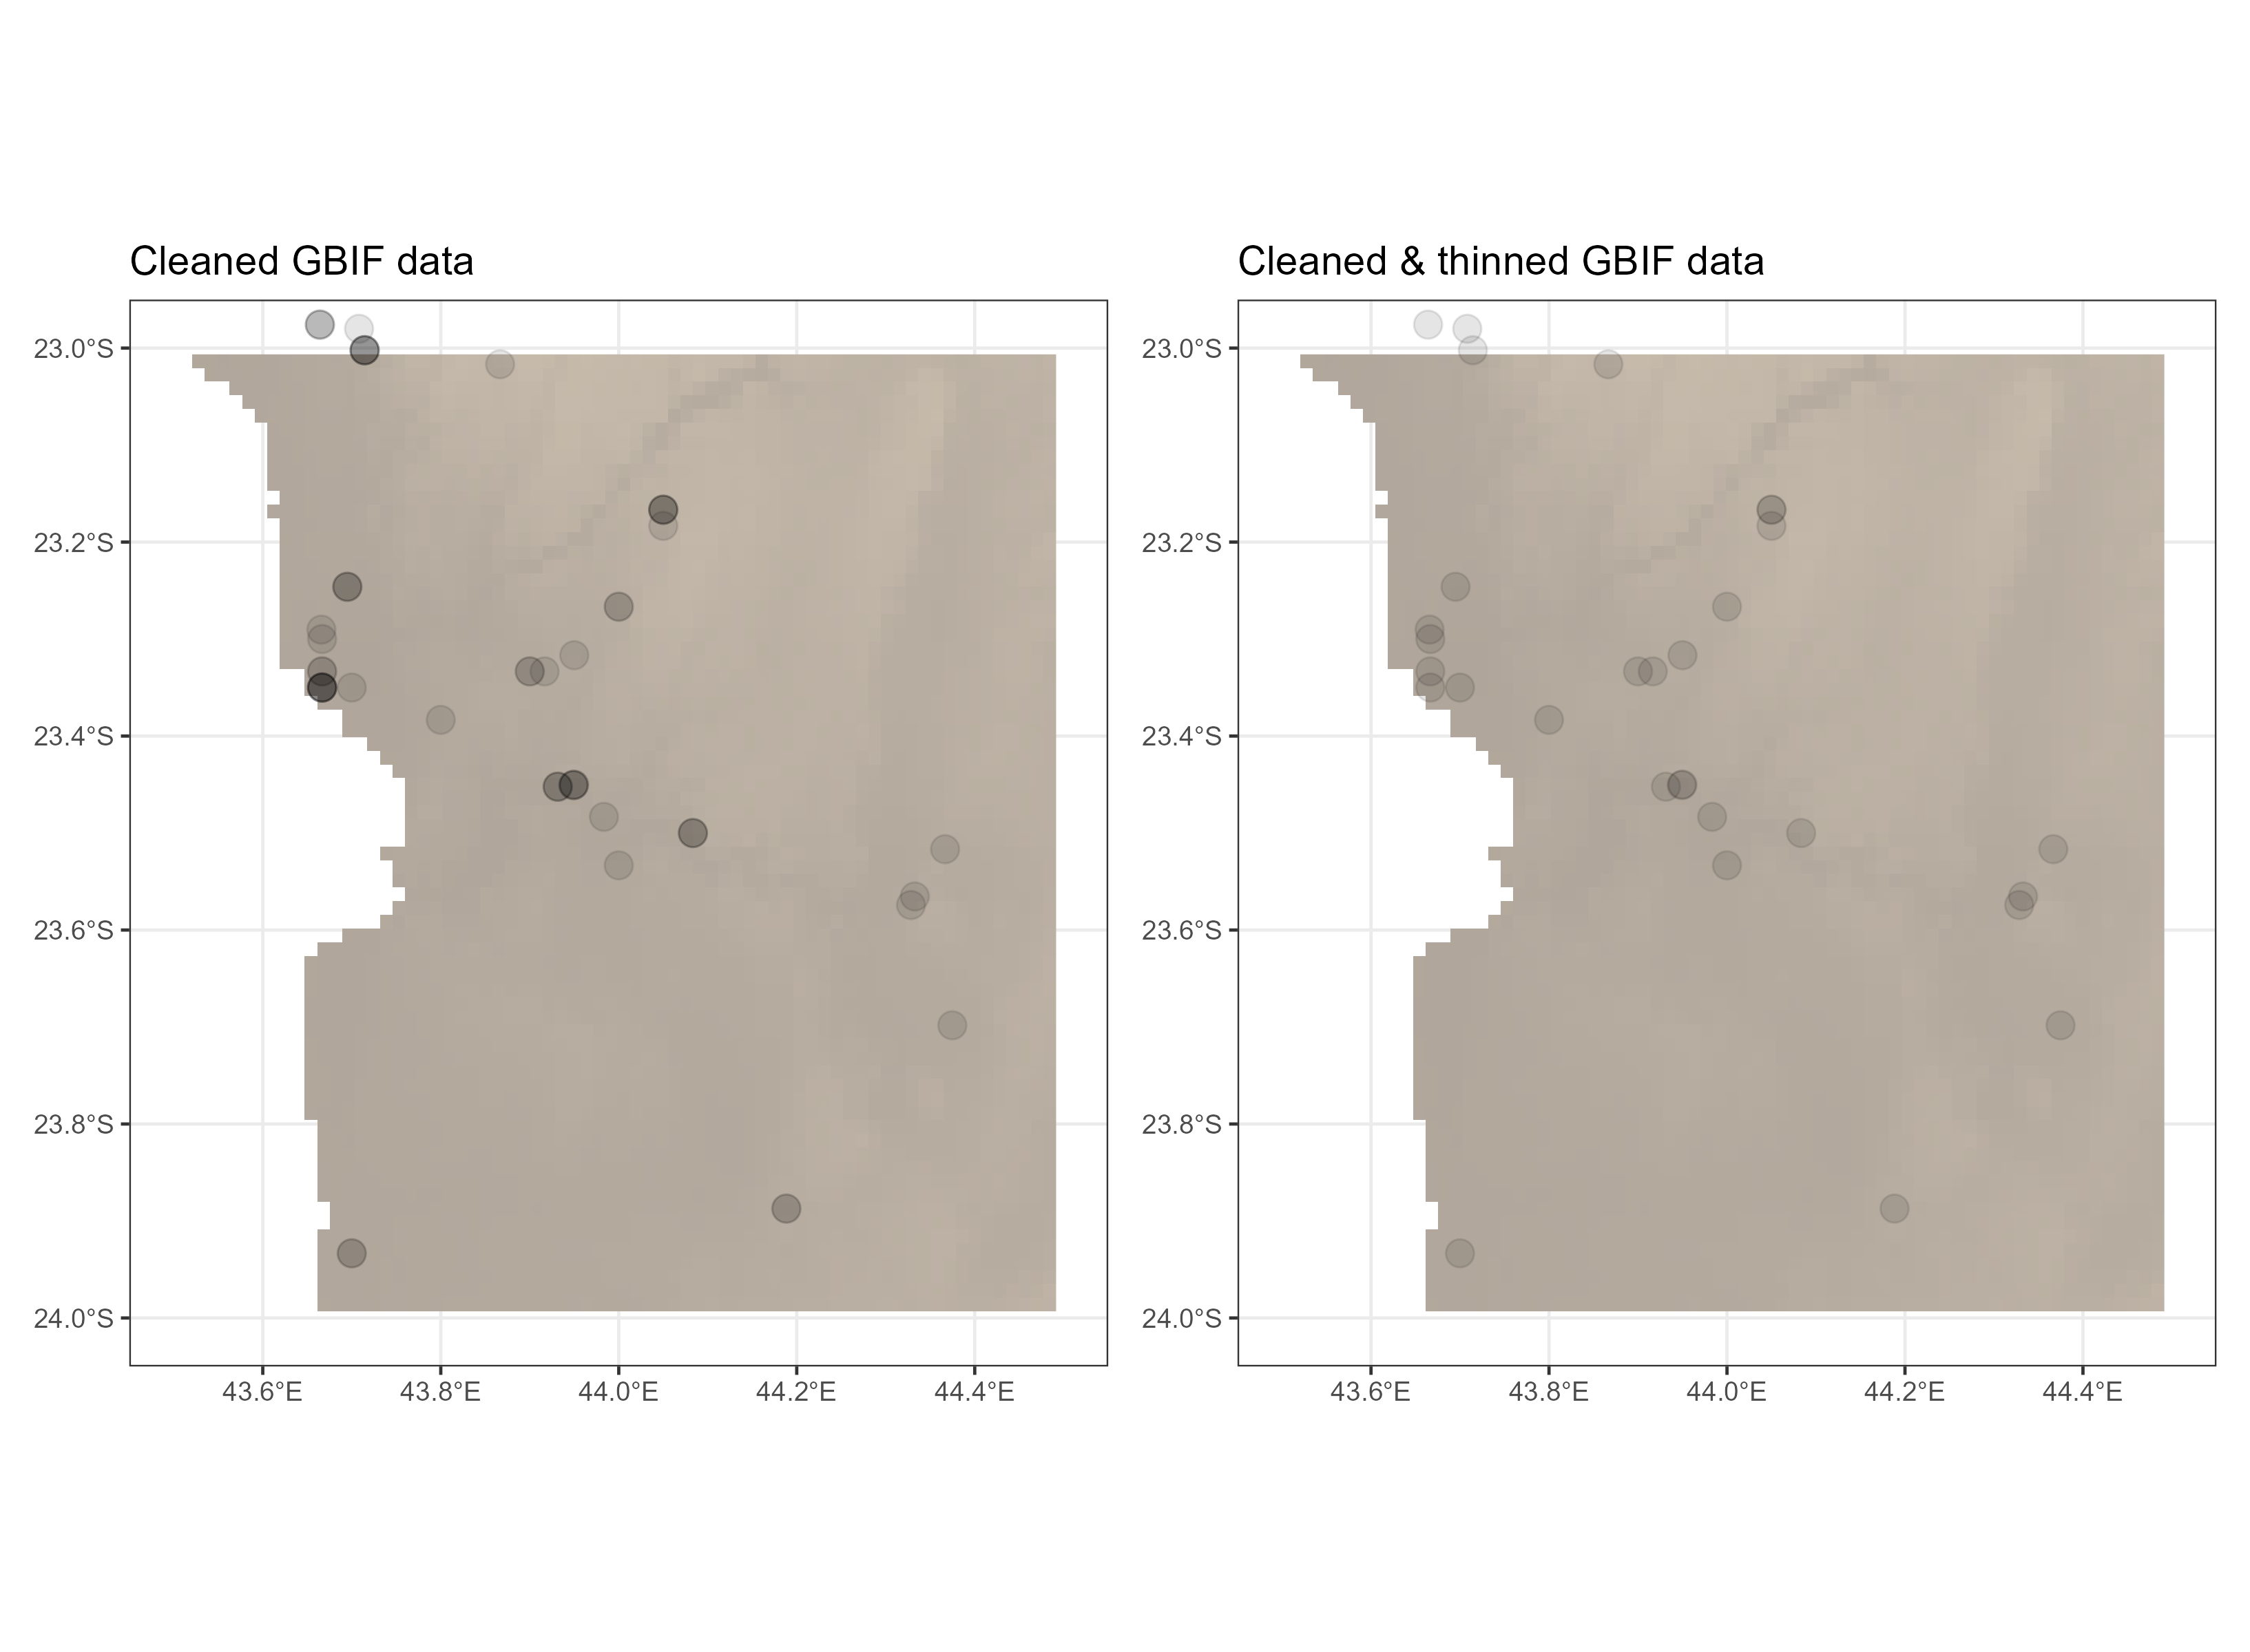
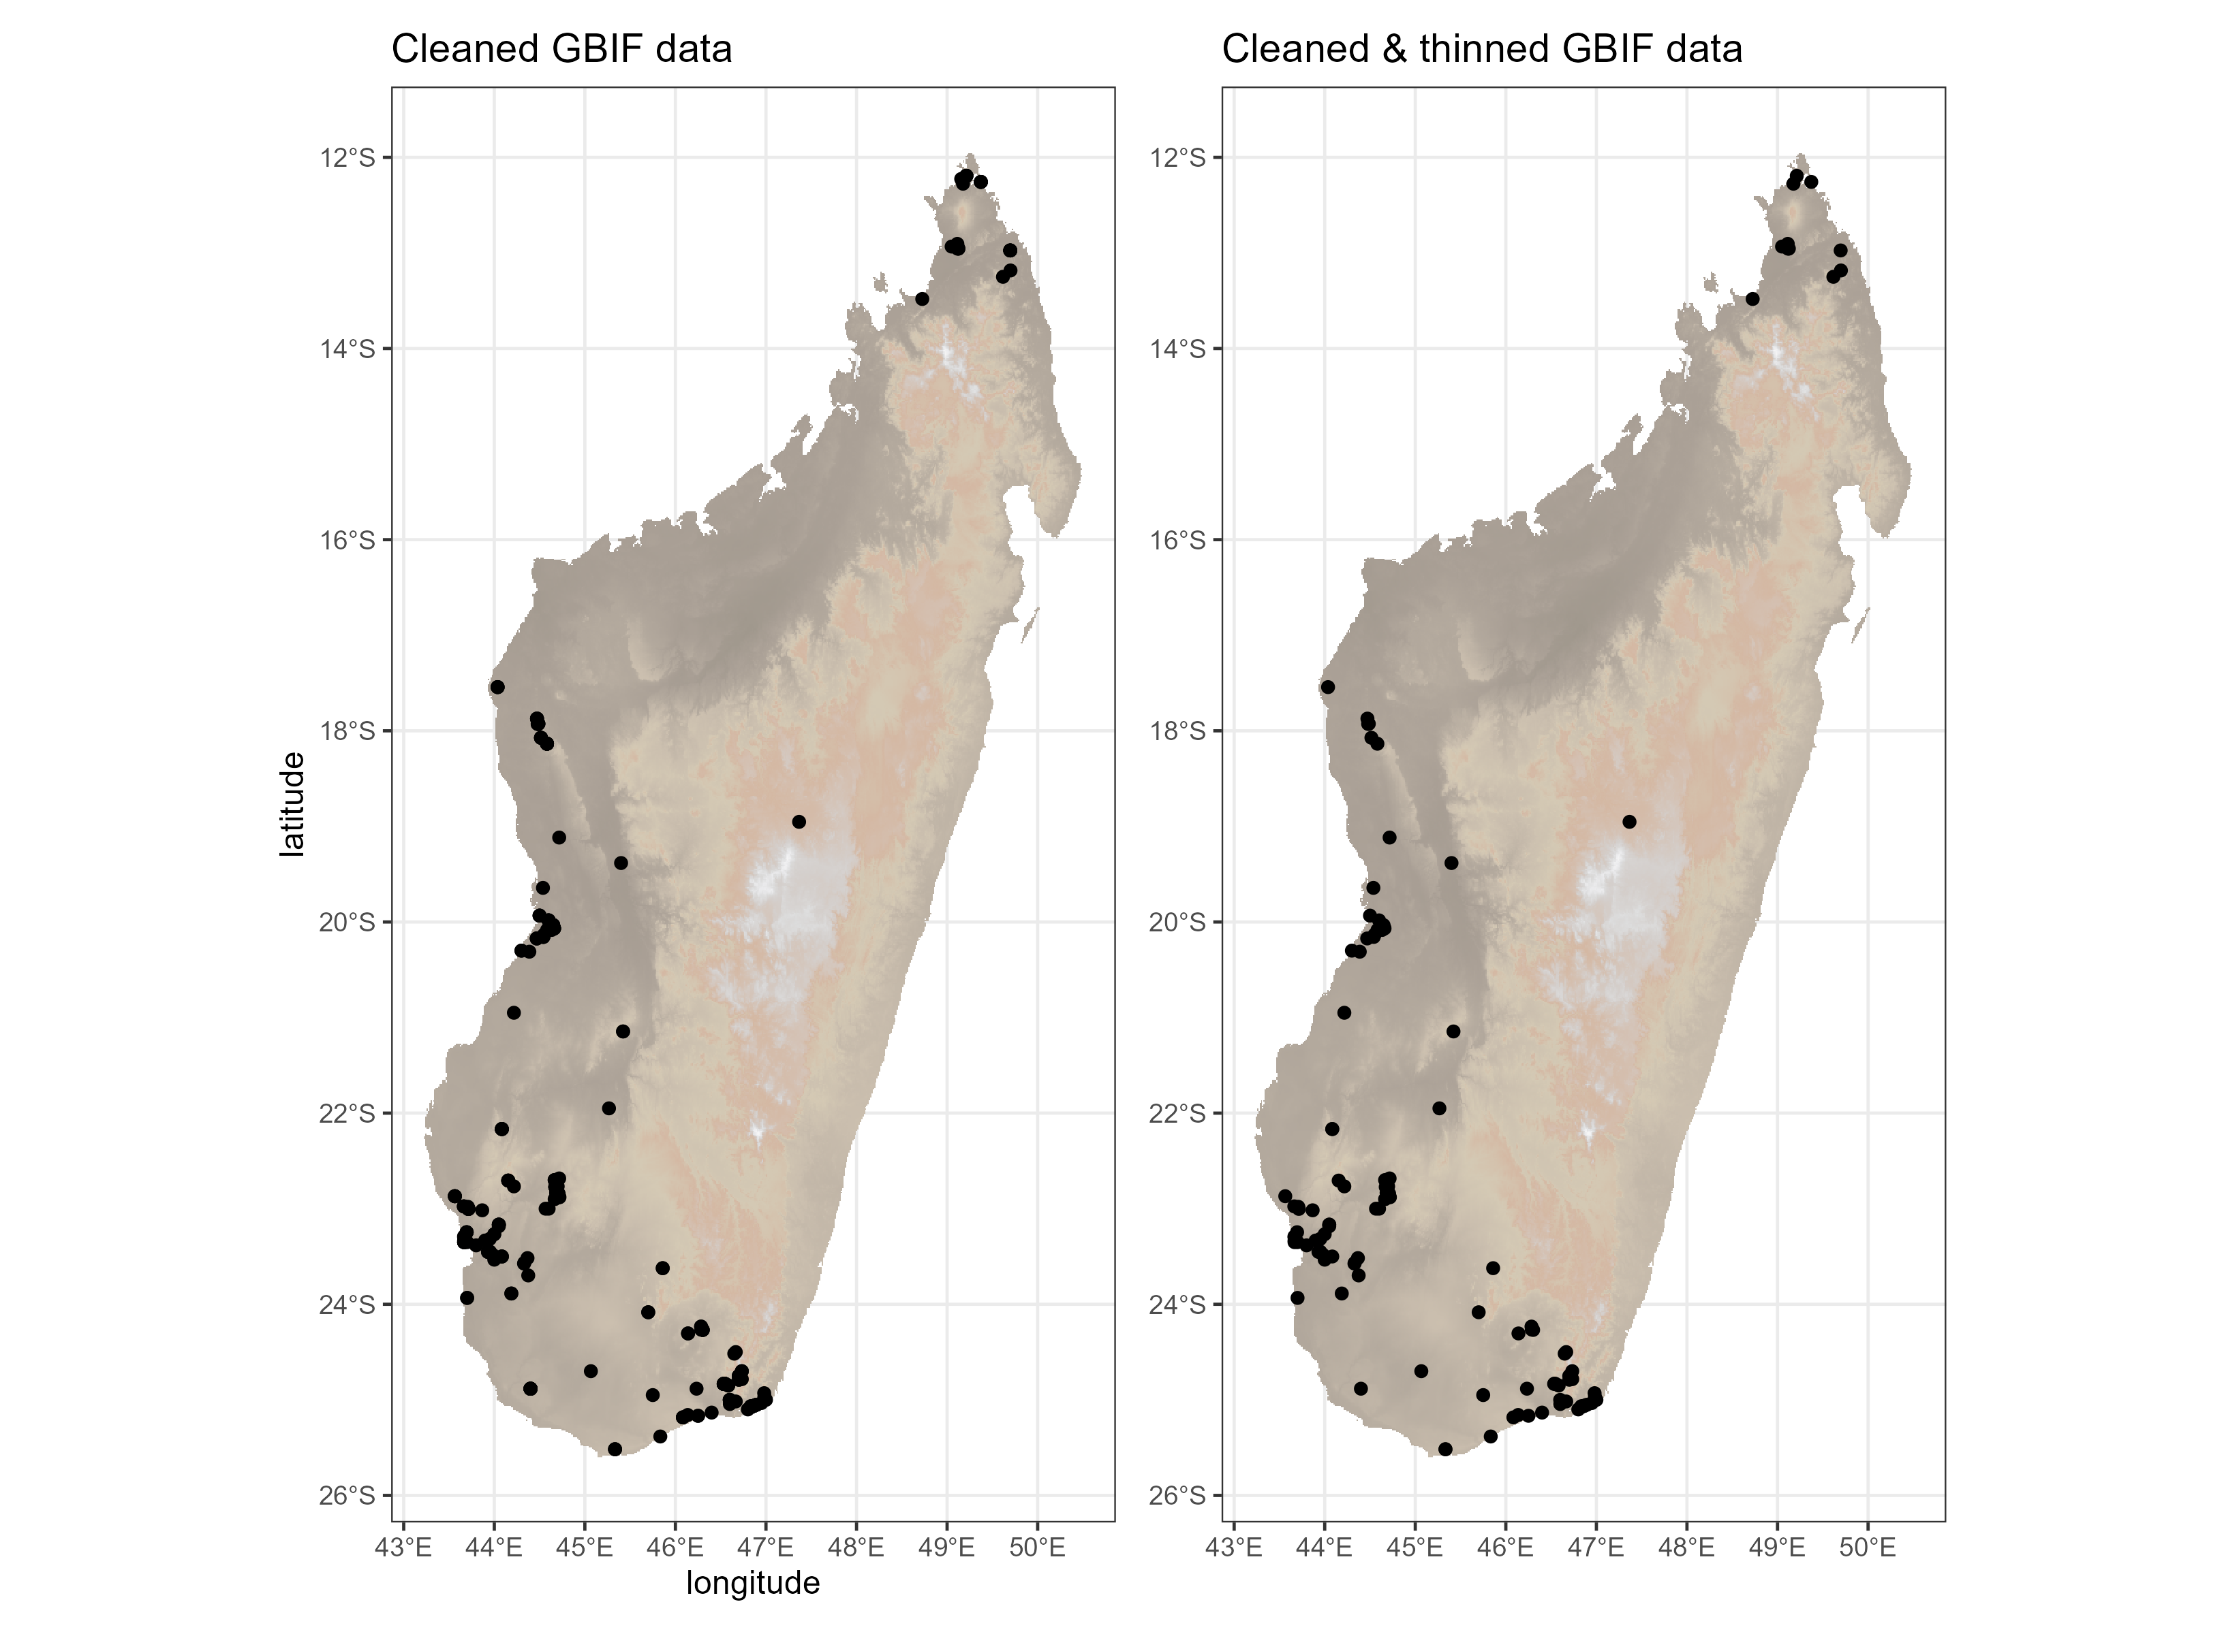
Hazard | Problem | Recommendation
2. Biases in biological sampling | Collection biases | Spatial thinning
tidysdm::thin_by_cell(); 1 record per grid cell, to avoid oversampling the same location/information

Slide 8

Hazard | Problem | Recommendation
2. Biases in biological sampling | Collection biases | Spatial thinning
Raw GBIF data | 310
Cleaned | 277
Cleaned & thinned | 126
Bauhinia madagascariensis

Slide 9
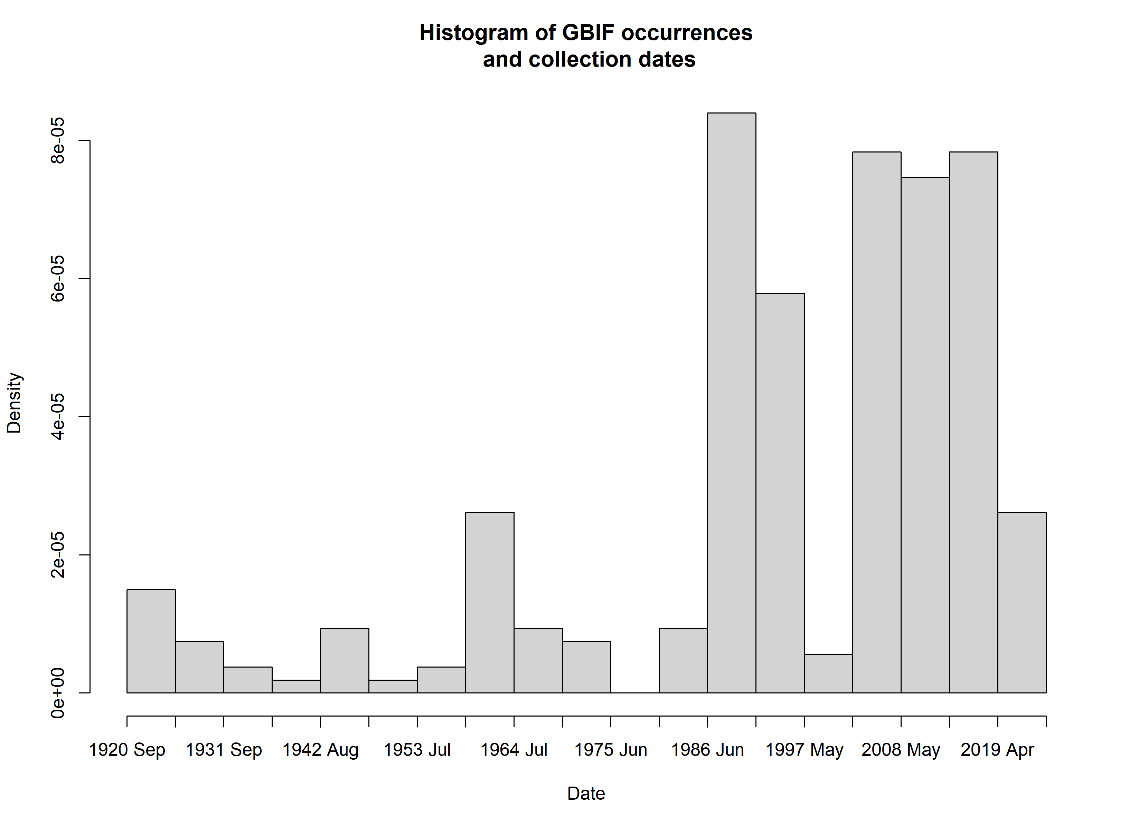
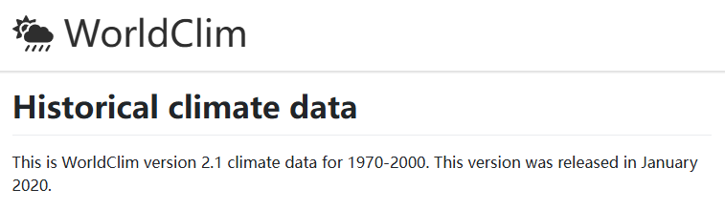
Hazard | Problem | Recommendation
3. Spatio-temporal inconsistencies in environmental vars | Erroneous direct/indirect correlations (e.g. elevation relationships differ with latitude) | Carefully select variables and occurrence records

Slide 10
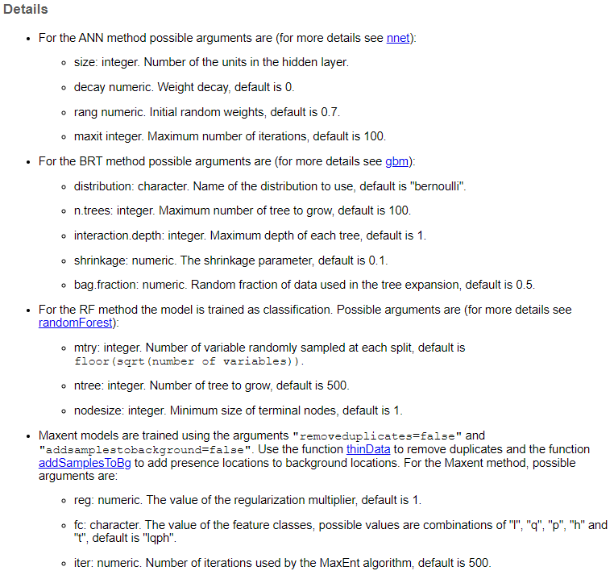
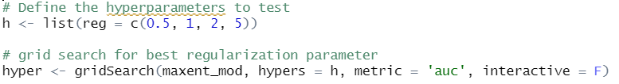
Hazard | Problem | Recommendation
4. Using default settings | Estimates highly sensitive to model parameters | Tune your parameters (i.e. test several combinations)
parameters
Tuning & selecting best parameters
based on AUC values
tidysdm::sdm_metric_set()

Slide 11
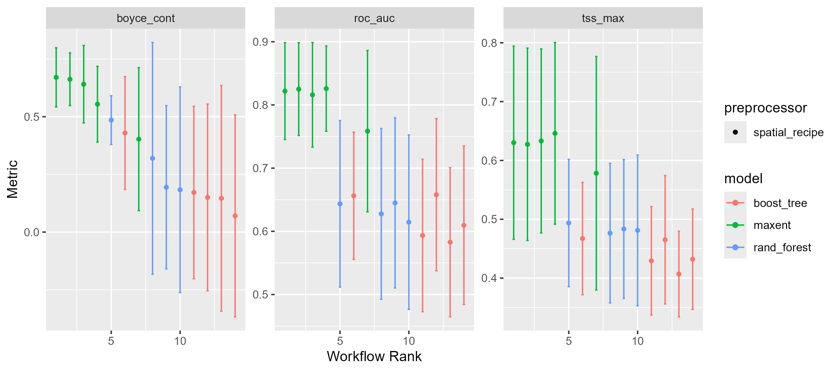
Hazard | Problem | Recommendation
4. Using default settings | Estimates highly sensitive to model parameters | Tune your parameters (i.e. test several combinations)
3 algorithms
5 different sets of parameters
= 15 models
We then select our best performing models based on the evaluation metrics and average the output

Slide 12
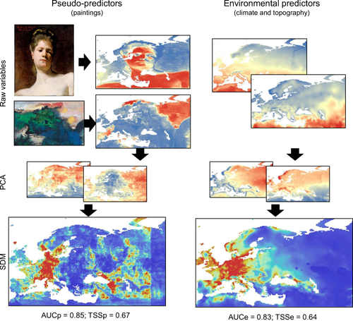
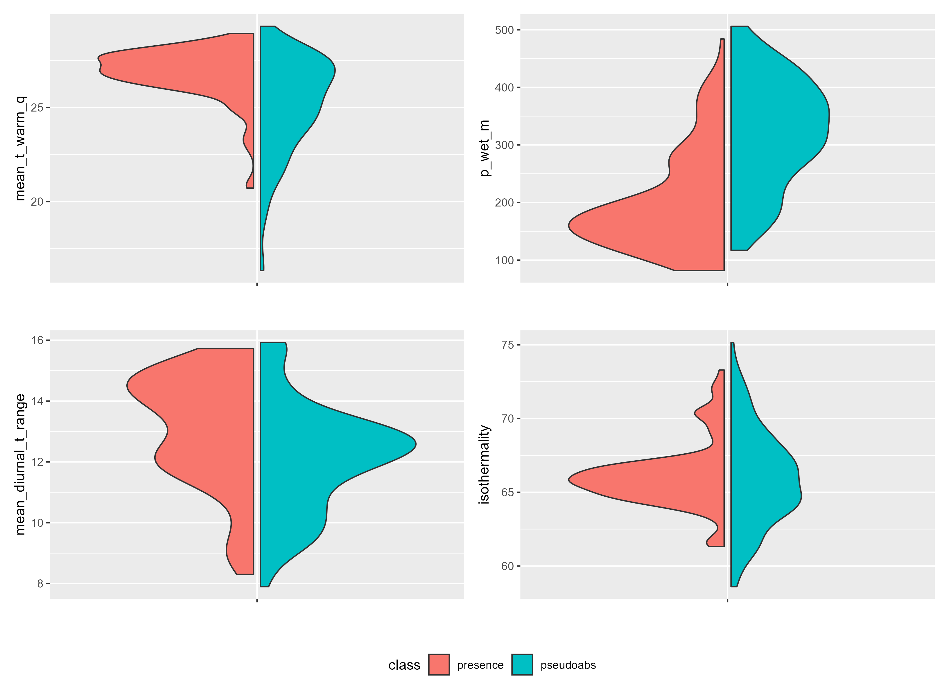
Hazard | Problem | Recommendation
5. Reducing env. vars irrespective of information content | Discarding informative environmental relationships | Identify variables based on biological relevance
tidysdm::plot_pres_vs_bg()
https://doi.org/10.1111/geb.12684

Slide 13
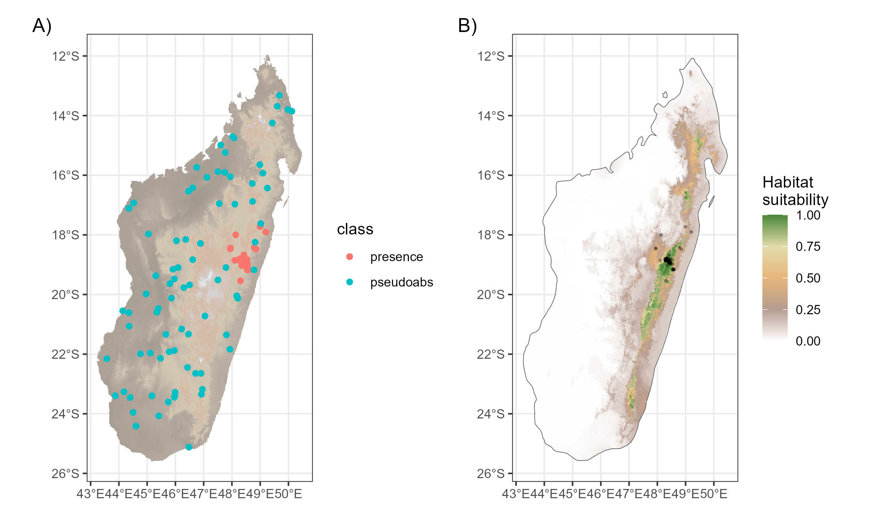
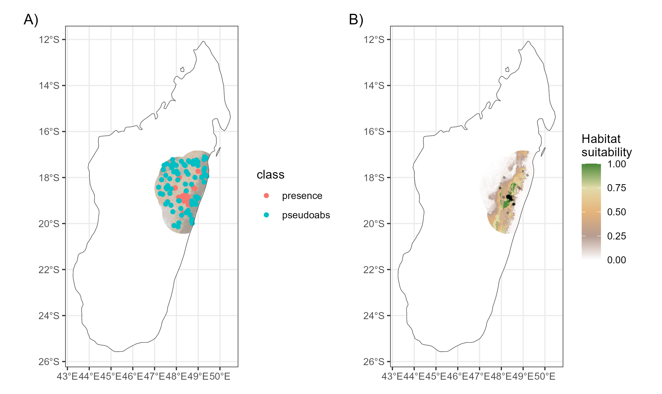
Hazard | Problem | Recommendation
6. Overly large study region | Violating assumptions on spatial equilibrium (e.g. dispersal opportunities) | Using biogeographic regions or carefully select area of interest
Full biogeographic region
e.g. Madagascar island
Areas buffered around
occurrences

Slide 14
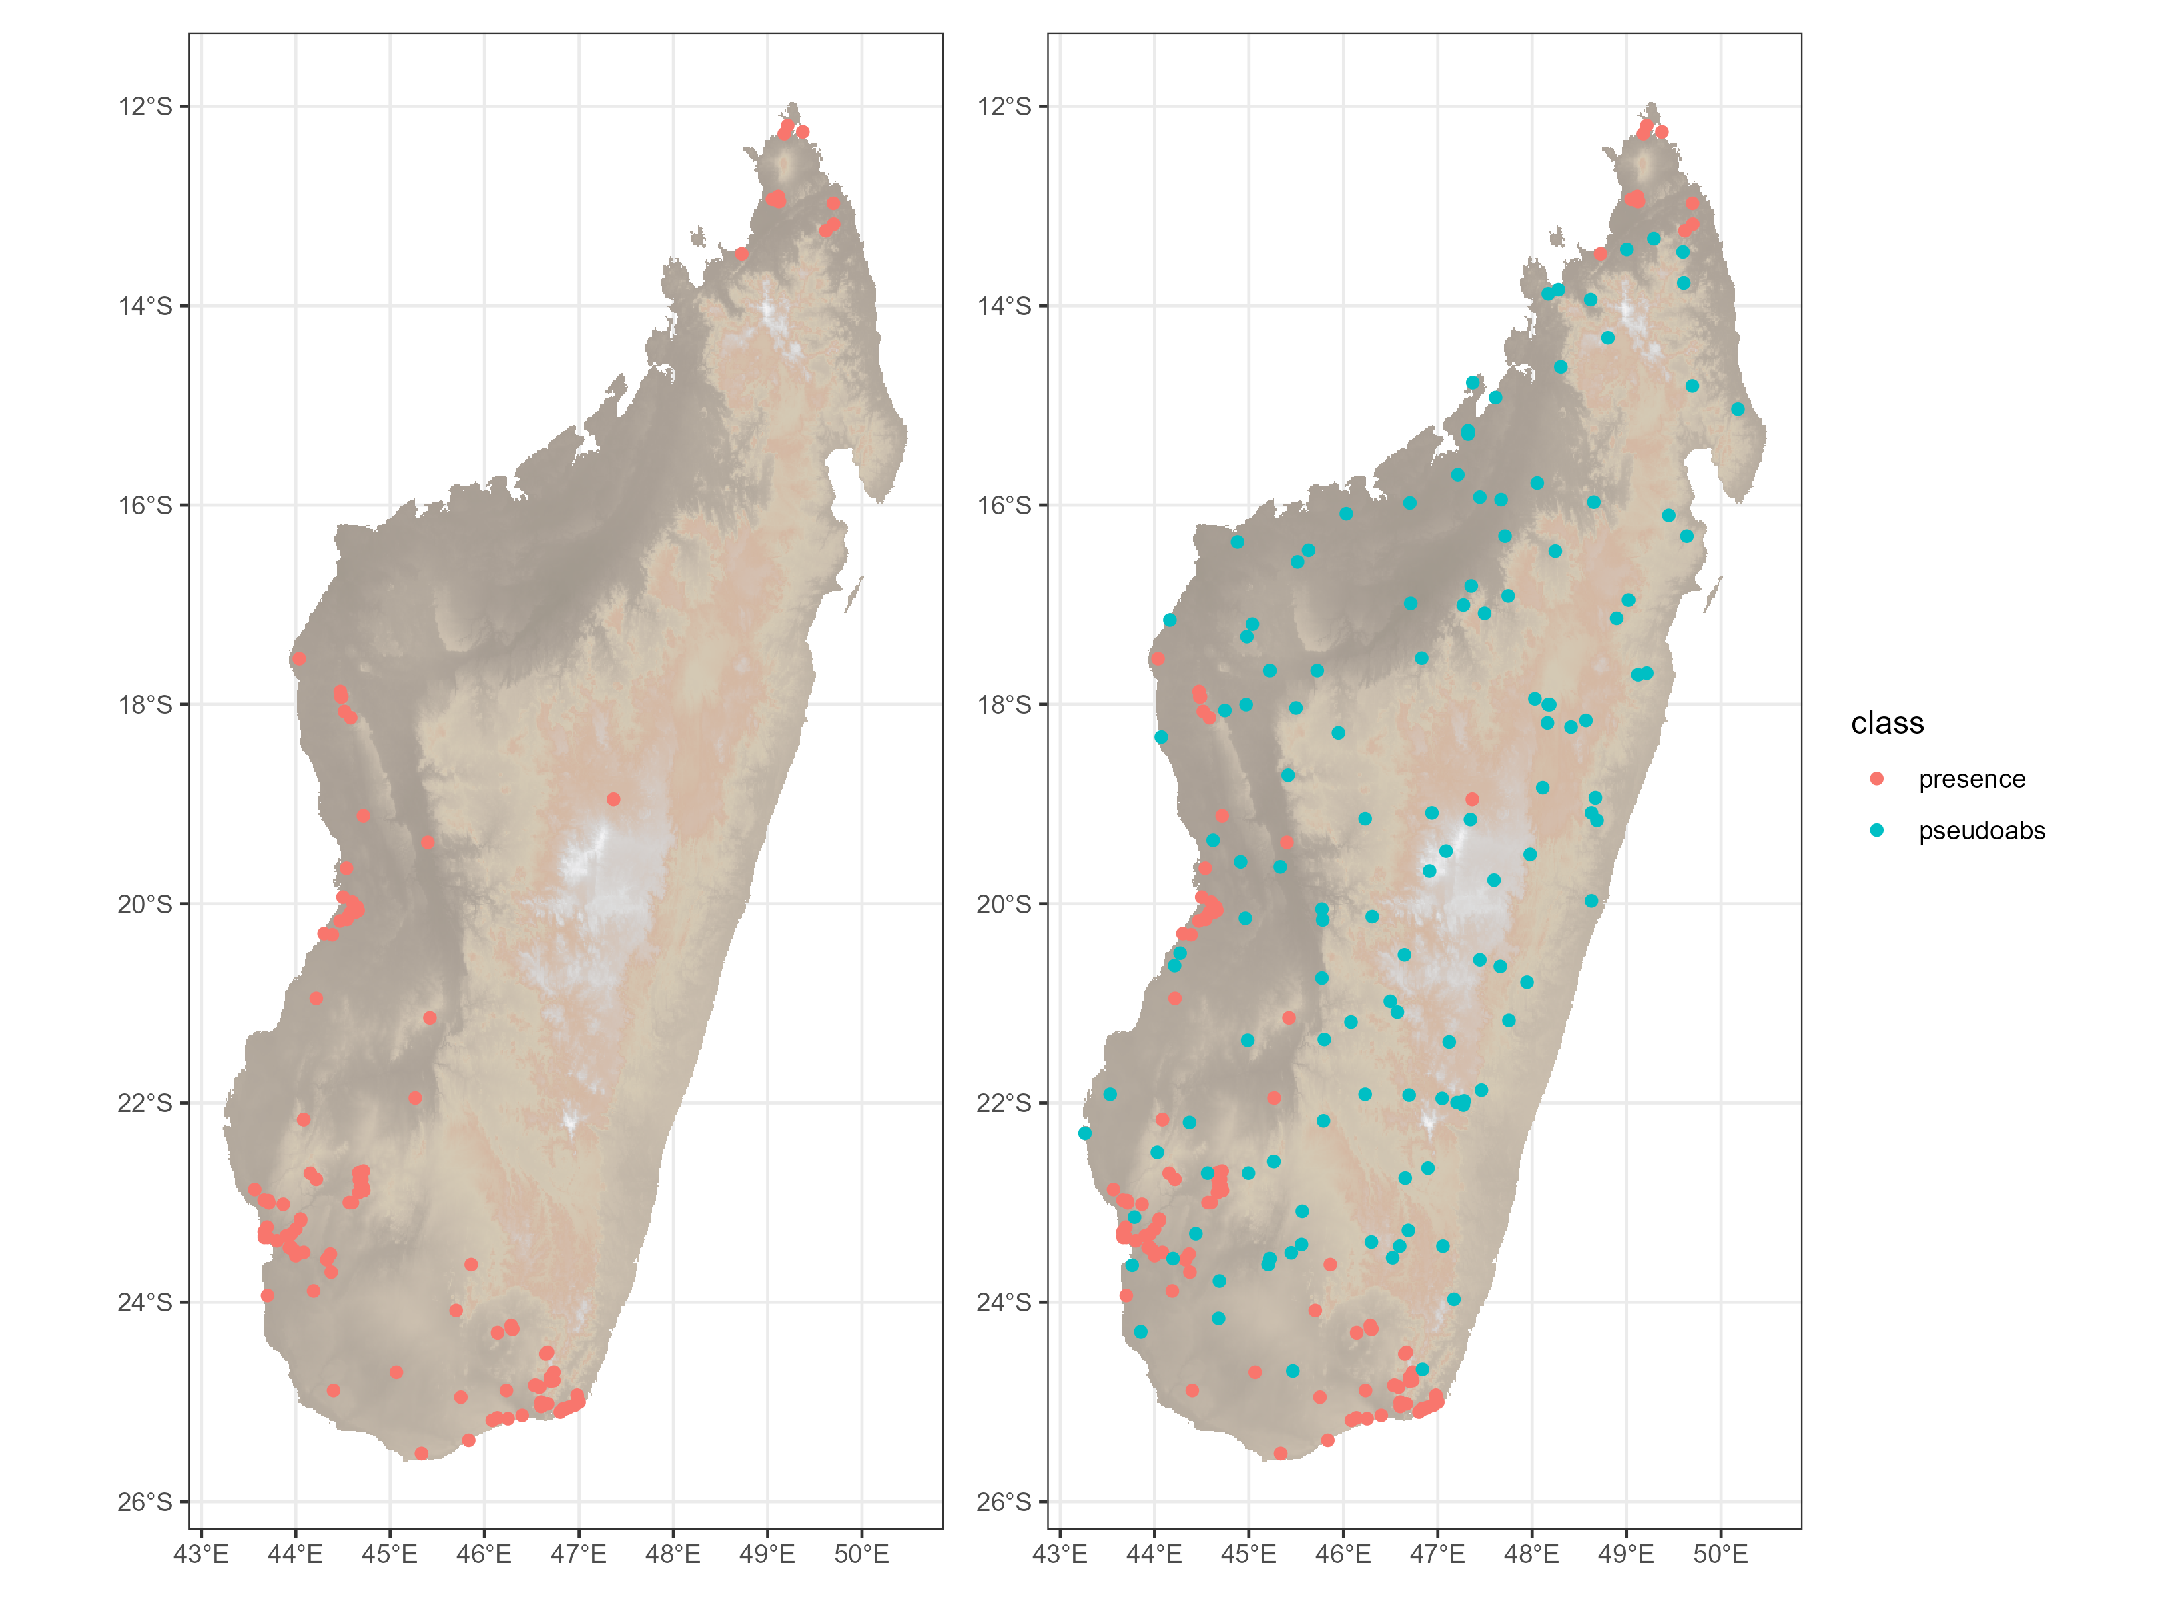
Hazard | Problem | Recommendation
7. Misinterpreting evaluation metrics | Background/pseudo-absences prone to biasing indicators of model performance | Use metrics that rely on presence data (e.g. Boyce index)
Background/pseudo-absences:
Produced by the user
Random/targeted/full background
Creates an issue when using evaluation metrics that are testing the ratios of:
True positives
False positives
True negatives
False negatives

Slide 15
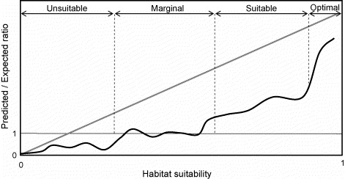
Hazard | Problem | Recommendation
7. Misinterpreting evaluation metrics | Background/pseudo-absences prone to biasing indicators of model performance | Use metrics that rely on presence data (e.g. Boyce index)
“A Boyce index close to 1 indicates that the model's predictions are consistent with the presences’ distribution, while a value close to −1 indicates that the model predicts unsuitable areas where presences are more frequent. A value around zero means that the model is not different from a random model.”
- Jimenez & Soberon 2020
Spearman rank
correlation
coefficient:
-1 to 1
Ideal model
Worse than
random model
Actual model (0.4-0.6)
Random model
https://doi.org/10.1111/2041-210X.13479
https://doi.org/10.1016/j.ecolmodel.2006.05.017

Slide 16
Hazard | Problem | Recommendation
8. Using random splits | Random splits do not provide independent datasets due to spatial autocorrelation | Use spatial or environmental splits of the data
Dataset
Training (~75%)
Evaluation (~25%)
Evaluation (~25%)
Training (~75%)
Needs X repetitions

Slide 17
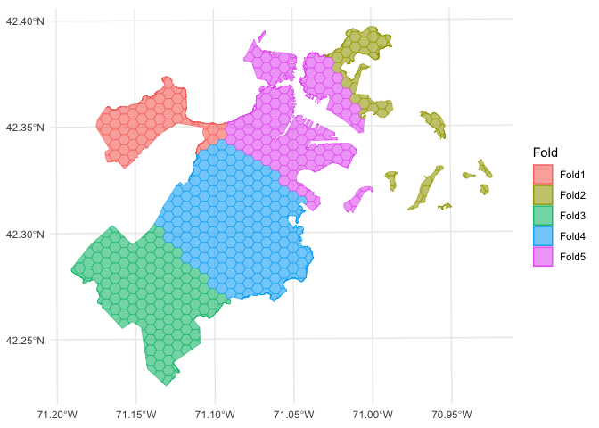
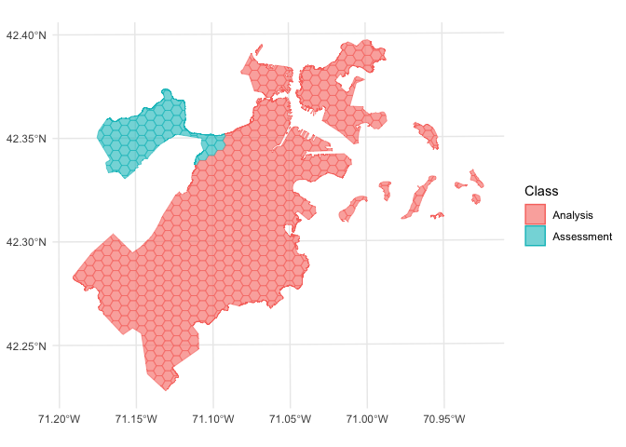
Hazard | Problem | Recommendation
8. Using random splits | Random splits do not provide independent datasets due to spatial autocorrelation | Use spatial or environmental splits of the data
spatialsample.tidymodels.org

Slide 18
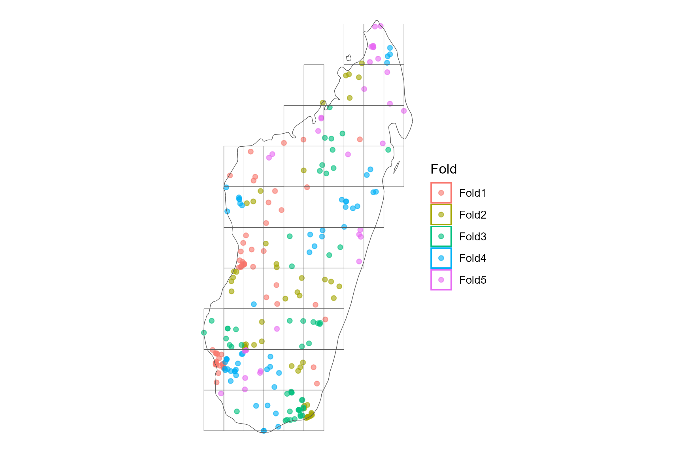
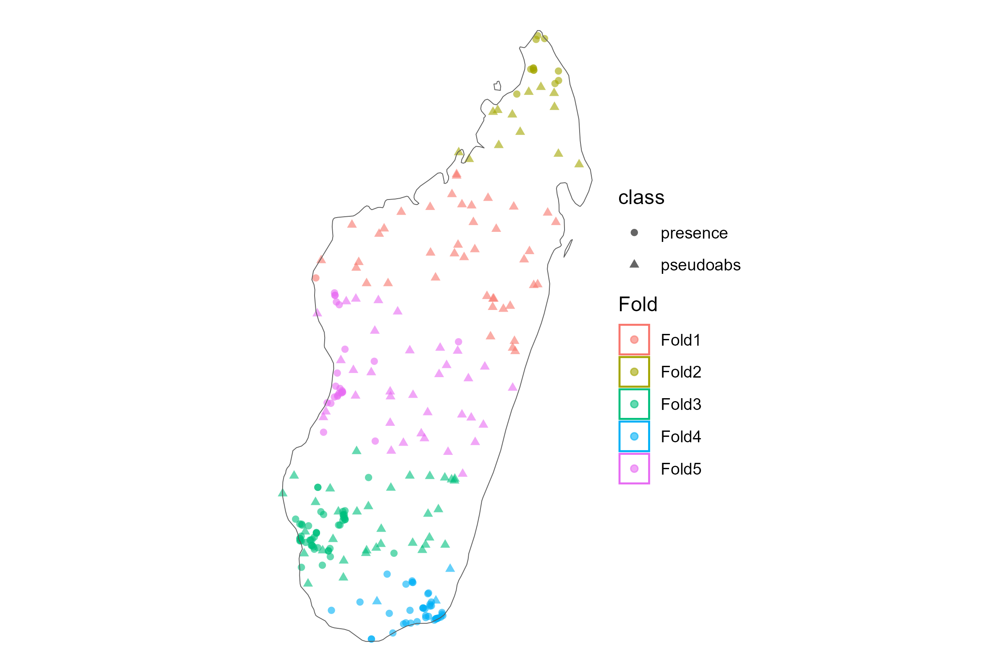
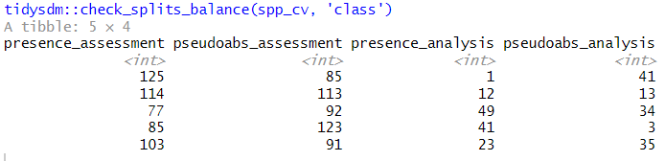
Hazard | Problem | Recommendation
8. Using random splits | Random splits do not provide independent datasets due to spatial autocorrelation | Use spatial or environmental splits of the data
spatialsample::spatial_clustering_cv ()

Slide 19
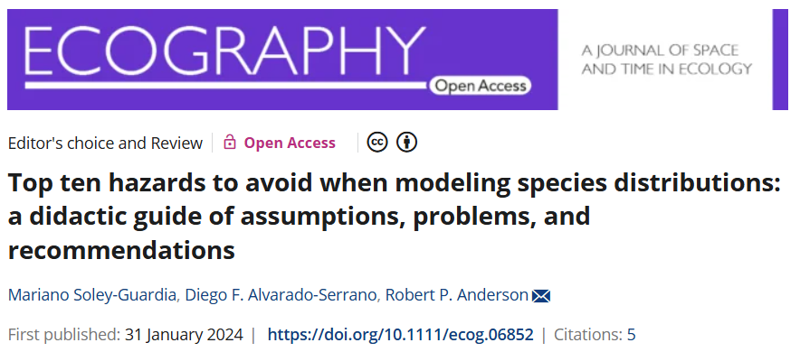
Hazard | Problem | Recommendation
9. Effects of extrapolation | Predicting beyond the known spatial or environmental range of a species | Reduce study region; Calculate degree of environmental novelty
10. Comparing outputs | Assumptions of species equilibrium risks faulty comparisons | Interpret outputs carefully; Maintain similar pipeline if comparing species predictions

Slide 20
Full workflow
Data gathering & processing
Model evaluation
Application
Model building
Model interpretation
methods (report all steps)
Download raw GBIF data
Clean & thin data
Select environmental data
Generate pseudo-absences
Fit & evaluate models
Spatial cross-validation
Tune hyper-parameters
Predict habitat suitability
Fit & evaluate models
Threshold probability map
Variable importance
Response curves
Protected area analysis
results
(report these values, figures, tables)

Slide 21
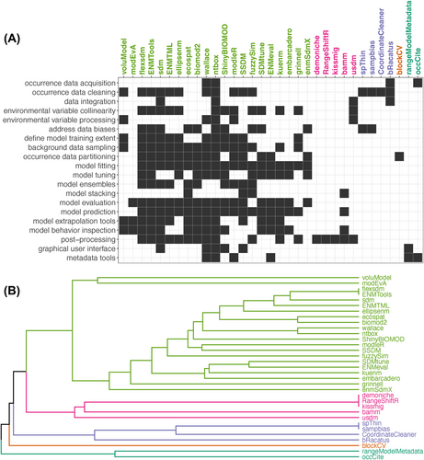
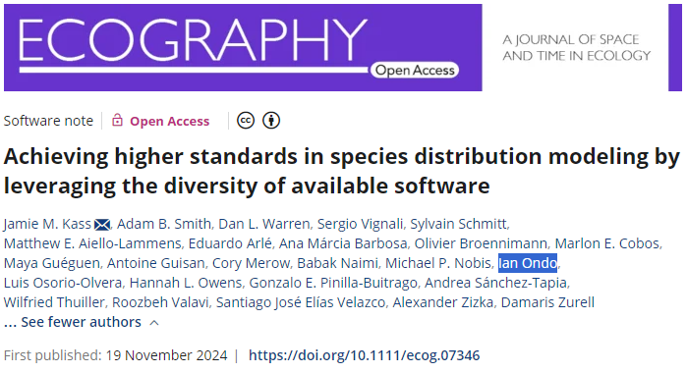

Slide 22
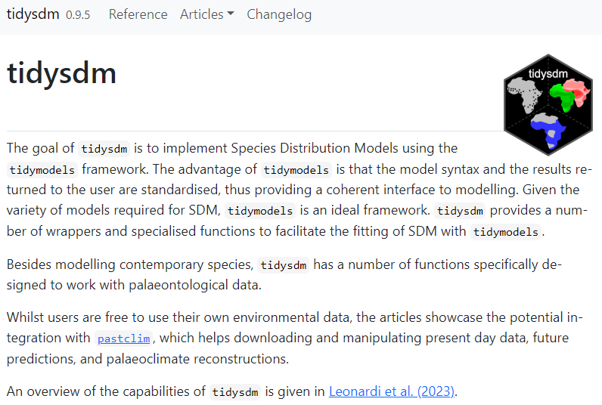
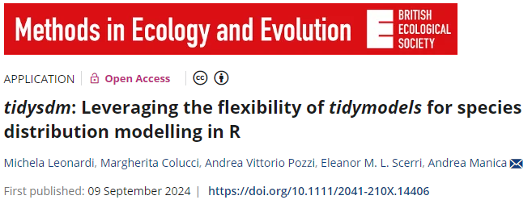
evolecolgroup.github.io/tidysdm/

Slide 23
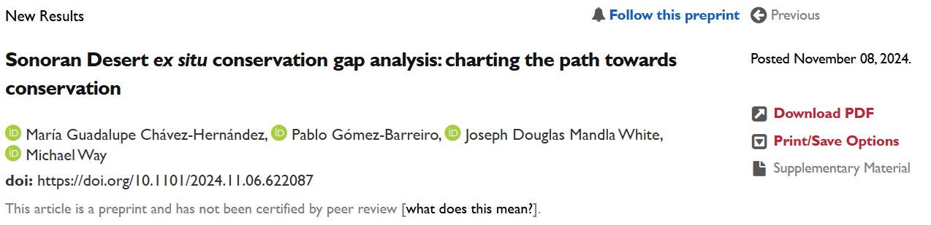
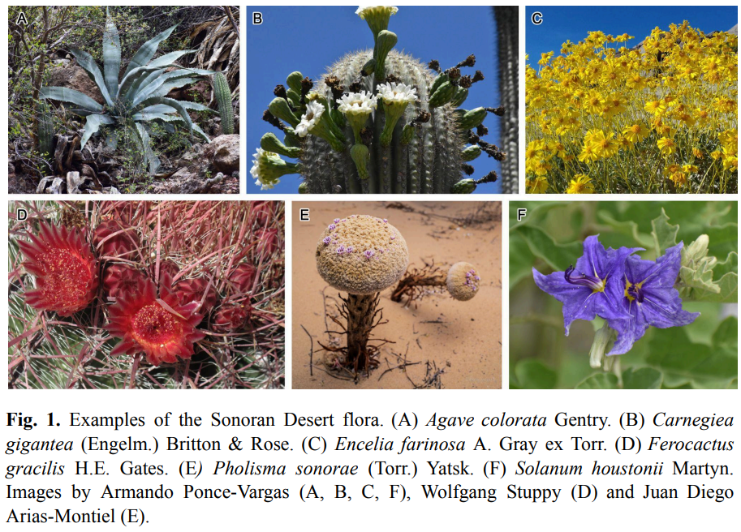
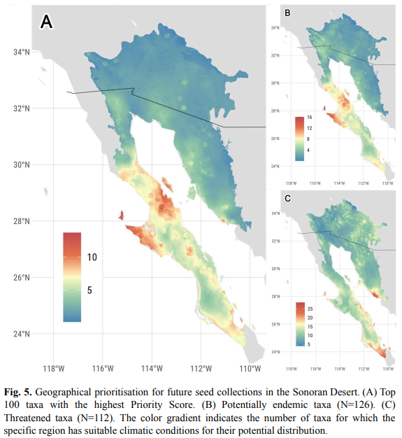

Slide 24
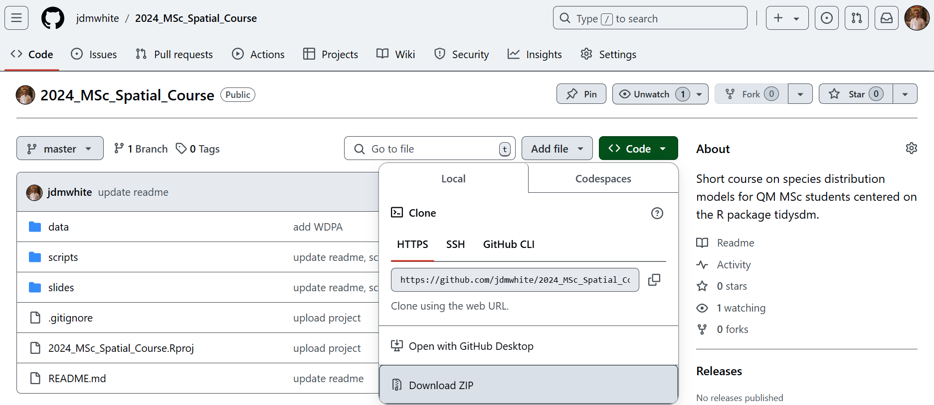
Practical – download material
github.com/jdmwhite/2024_MSc_Spatial_Course

